Slide 1
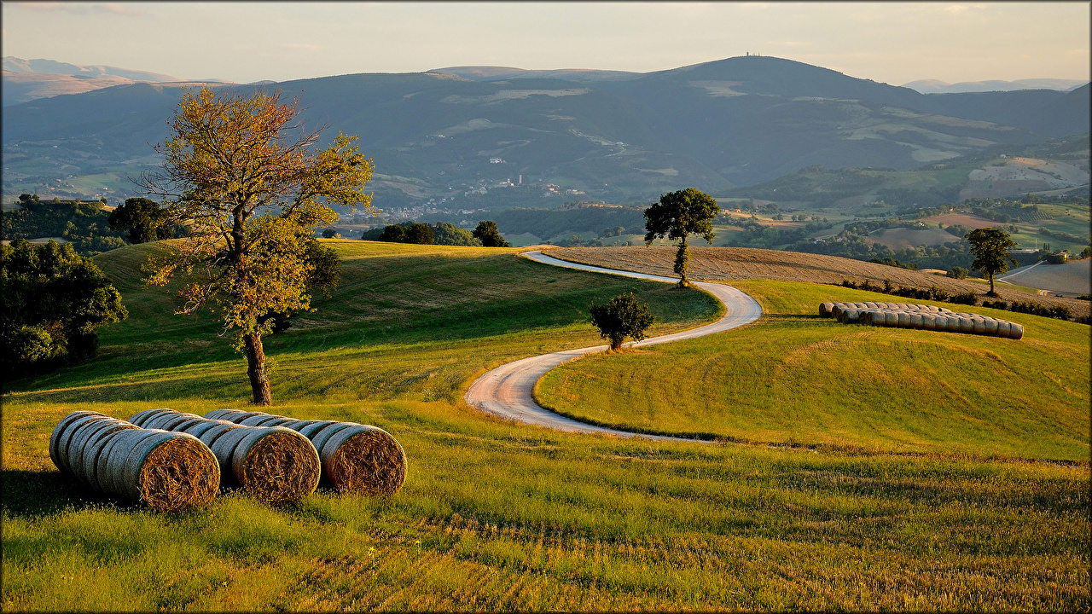
Maurel Valentin
Duclaux Louison
Alternative agriculture
The 12th of February, 2018

Slide 2
Summary
Definitions
History
Farming practices
Advantages and drawbacks
Alternative versus Organic
Alternative versus Intensive

Slide 3
Definitions
Alternative agriculture : systematic approach to farming intended to reduce agricultural pollution and improve sustainability. Alternative agriculture can be made at different scales : at home or for significant production.
Organic agriculture : production system that sustain the health of soils, ecosystems and people. It is a label use only for significant productions which make a profit.

Slide 4
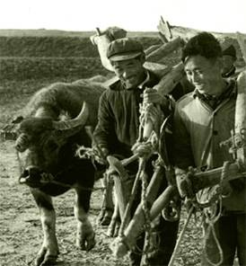
History
First used in the USA by J.I Rodale in the 1950s
Vegetarian movement of 19th century
Research on the connection between the condition of the soil, food quality, and human health in the 20th century

Slide 5
Statistic

Slide 6


Farming practices :
Respect and preserve consumers, farmers, nature, earth and plants
Limit the use of pesticides
Promote the natural dynamism of earth (no mono-cropping)
Limit the gas emissions
Promote access to quality food
Promote animals’ well-being and happiness

Slide 7
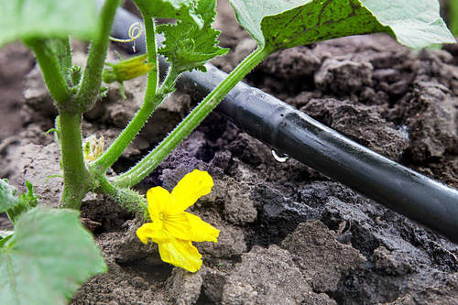
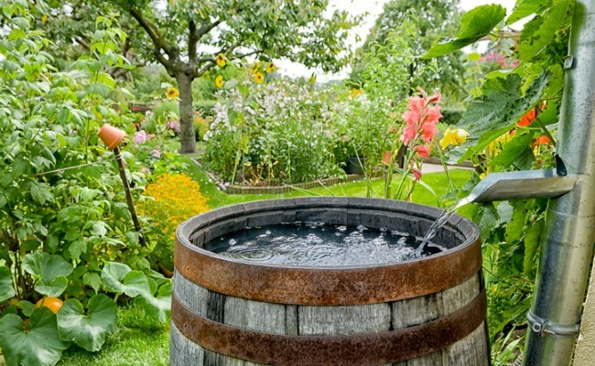
Irrigation
Use of wastewater (need treatments)
Rainwater
Limit the waste → study the needs of the crops
Drip irrigation system

Slide 8
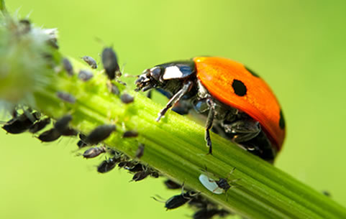
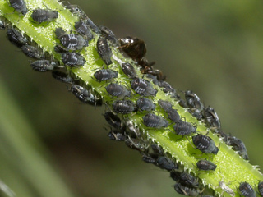
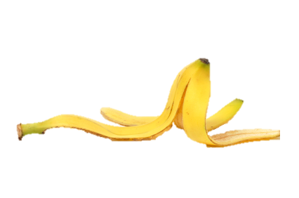
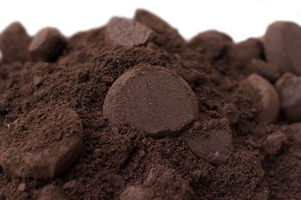
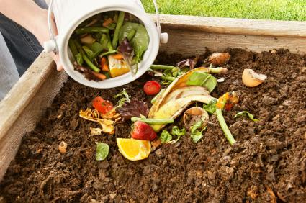
Example 1 : the use of food chain
Insertion of ladybugs to remove aphids
Example 2 : natural fertilizer
Coffee ground, banana skin, wood ash, compost

Slide 9
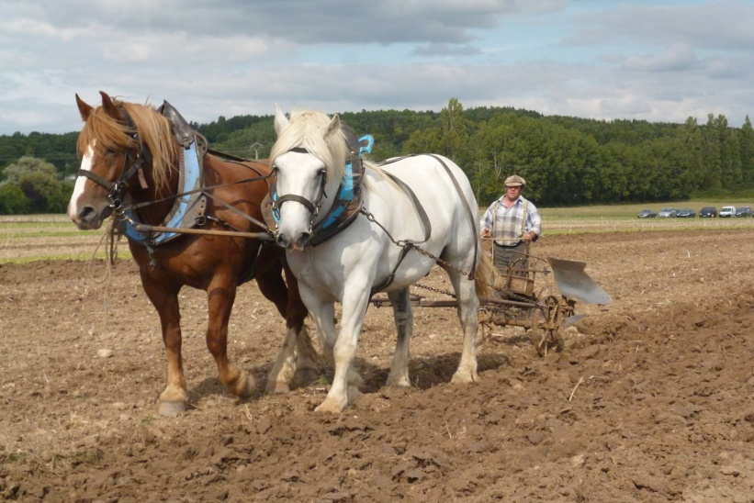

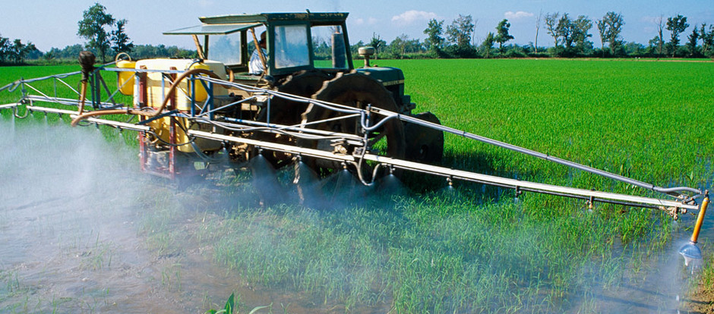
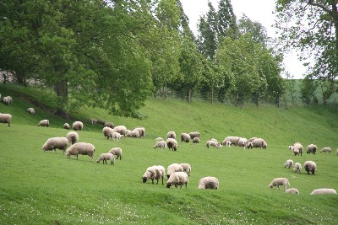
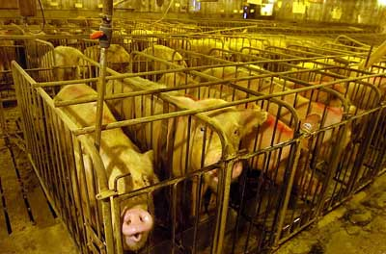
Example 3 : Ancestral work with animals
Example 4: Transhumance and free- range

Slide 10
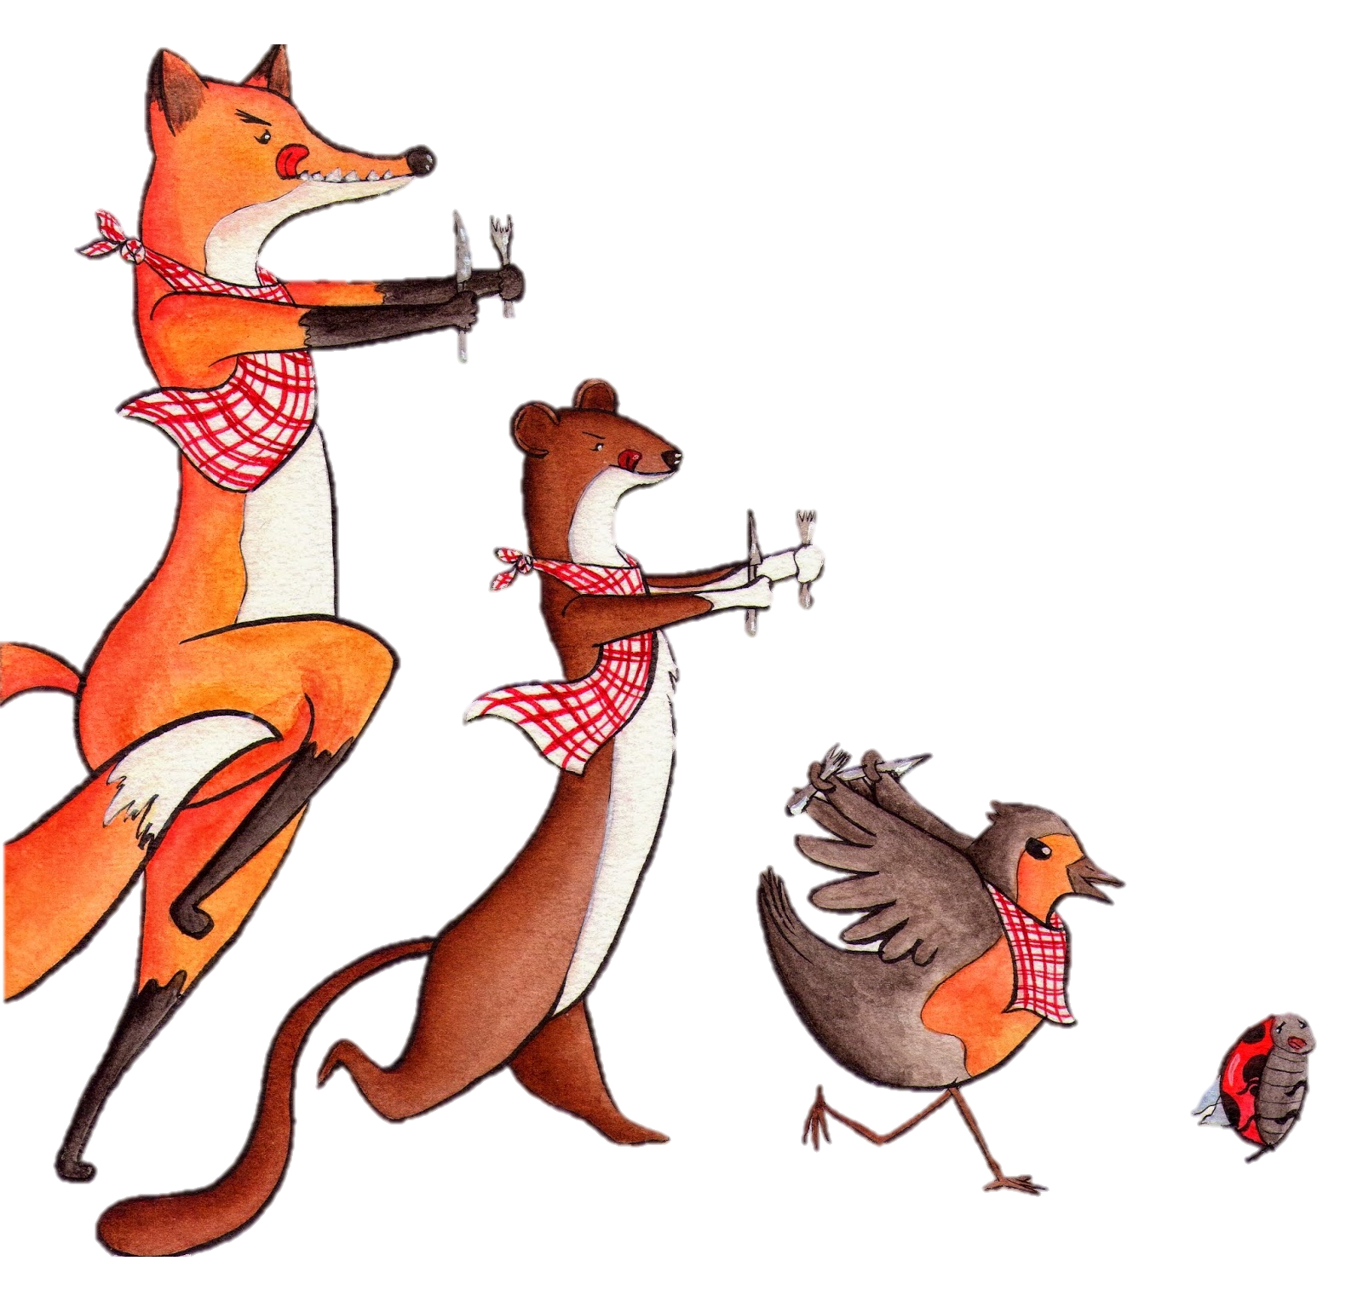
Advantages :
Non dangerous farming for fauna and earth
Protect the soil from erosion
Respect the food chain
Good for health
Limit waste

Slide 11



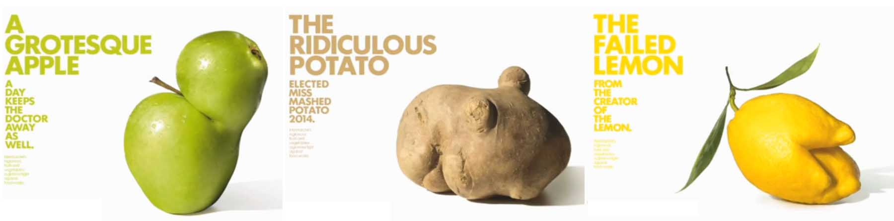
Drawbacks :
Expensive prices
More work
- Less esthetical vegetables and fruits (not a drawback for everyone)
Hard to grow with zero chemical
Lower yields

Slide 12
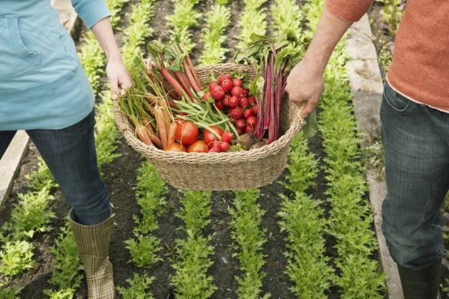
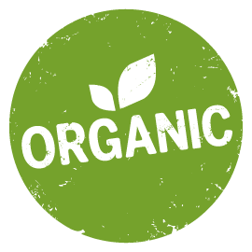
Differences between organic and alternative agriculture
Organic
Alternative
Label
Significant production
A type of alternative
Can be made at home, for subsistence farming
No strict rules

Slide 13
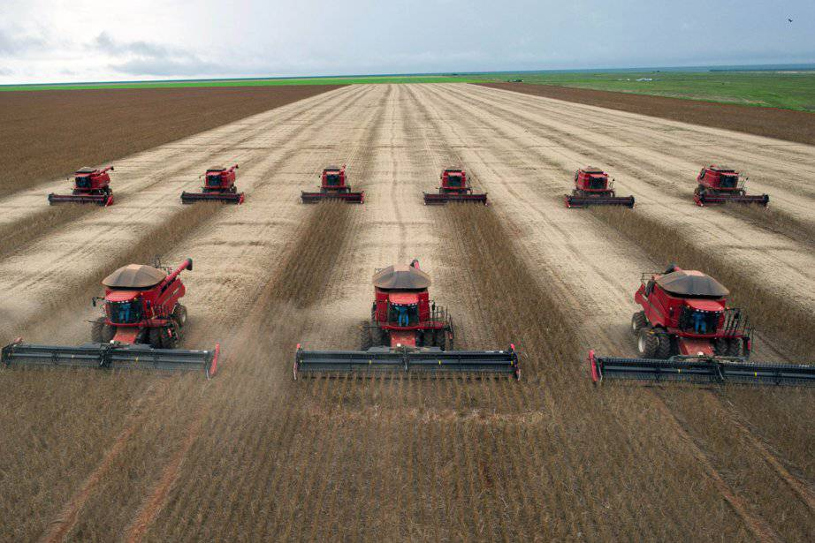
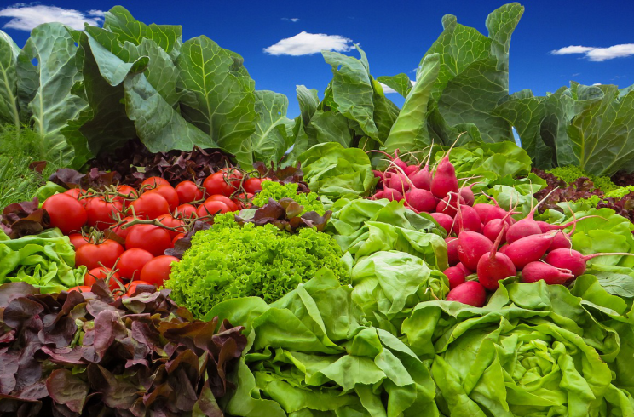
Differences between intensive and alternative agriculture
Intensive
Maximise yield of crops
Use of inputs
Do not respect the biological cycle of crops and livestock
Alternative
Do not focus on yield
Do not use inputs
Production system that sustains the health of soils, ecosystems and people

Slide 14
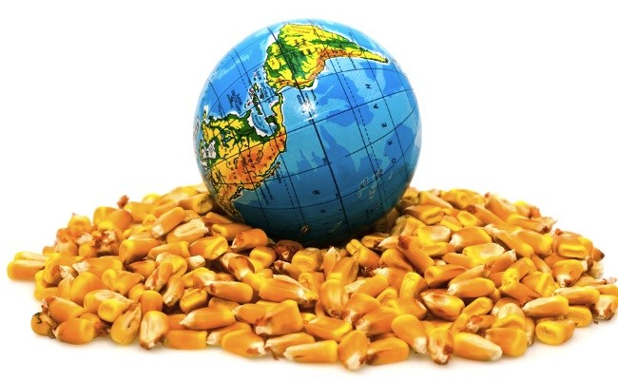
Feed the world thanks to alternative agriculture
-
9 billion people in 2050
Increase global food production by as much as 50%

Slide 15
Conclusion
Respect and preserve consumers, farmers, animals, nature, earth and plants.
Ensure the access to quality food.
The best solution to manage the growing population

Slide 16
Bibliography
http://www.teachmefinance.com/Scientific_Terms/Alternative%20agriculture%20.html#ixzz55yENmNGE
https://www.nal.usda.gov/afsic/sustainable-agriculture-definitions-and-terms.com
http://eap.mcgill.ca/AASA_1.htm
https://you.stonybrook.edu/environment/sustainable-vs-conventional-agriculture/
https://www.globalonenessproject.org/sites/default/files/downloads/Can%20Sustainable%20Agriculture%20Feed%20the%20World%3F.pdf
https://www.ecowatch.com/gmos-will-not-feed-the-world-new-report-concludes-1882023777.html

Slide 17

Thank you for your listening
Do you have any question ?

